Slide 1
Sun City Computer Club
Cyber Security SIG
April 7, 2022
Questions, Comments, Suggestions welcomed at any time
Even Now

Slide 2
Audio Recording In Progress SIG attendees are required to be members of the chartered club sponsoring that SIG. Sun City Community Association By-law
Audio recording of this session as MP4 file
Audio recording available at link shown above

Slide 3
Presenter???
Ever want to be a presenter??

Slide 4
Current Issues
Microsoft & Okta investigating attack from Lapsus$
FBI investigating 5 US energy firm scans
Apple service Outage 3/21/2022
Google Maps outage 3/18/2022
Altered software for selected attacks – geopolitical
OpenSSL infinite loop
MicroTik routers C&C proxies
Russia state actors
exploit PrintNightmare & default MFA
Ransomware speed 100,000 files
LockBit – 4 minutes 9 seconds
Babuk - 6 minutes 34 seconds
. . . .
Maze - 1 hour 54 minutes
Kaspersky Labs security
FinFisher shuts down

Slide 5
Apple Beta
Security Updates
Settings > General > VPN & Device Management
iOS Beta (or similar)
Remove that profile
Restart
Update

Slide 6
Apple digital IDs

Slide 7
Apple digital IDs
Security & privacy
Over physical IDs
Arizona
Soon? Colorado
Connecticut
Georgia
Hawaii
Iowa
Kentucky
Maryland
Mississippi
Ohio
Oklahoma
Territory of Puerto Rico
Utah

Slide 8
Apple digital IDs
iPhone 8 or later iOS 15.4
Apple watch series 4 or later watchOS 8.4
Wallet App
Drivers License or State ID
Add to iPhone and Apple Watch
Add to iPhone
Logon to state DMV to authorize
Take selfie Scan Front & Back
Secure transfer to state agency
State defined head or other movements
TSA using NFC readers
NOT a substitute for having license in owners' possession

Slide 9
Apple digital ID

Slide 10
Apple digital ID

Slide 11
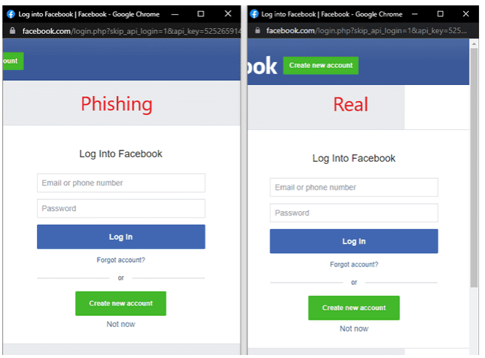
Browser in the Browser
Perfect? Convincing?
simulate Single Sign On
Sign in with {Google | Facebook | Apple| Microsoft }

Slide 12
Browser in the Browser
Exact & correct domain name
Right site? Check
Check URL? Check
Check for look-a-like characters? Check
Ready to use templates
10 days to in-the-wild detect

Slide 13
ATM Switch Attack

Slide 14
US Critical Infrastructure
Bill passed 3/10/2022
“substantial cyber incident” 3 days
ransom paid 24 hours
“Strengthening America Cybersecurity Act”
Removed from defense policy bill
Then passed with unanimous vote
What do they know?
CISA has 2 years to publish rules in Federal Register
Goal Whole of government response

Slide 15
Critical Infrastructure
Presidential Policy Directive 21, section 2242, subsection b
Chemical, Commercial facilities, Communications, Critical manufacturing, Dams, Defense industrial base, Emergency services, Energy, Financial services, Food and agriculture, Government facilities, Healthcare and public health, Information technology, Nuclear reactors, Materials and waste, Transportation systems, Water and wastewater
Subpoena power
Civil or Criminal penalty?

Slide 16
Current Issues
Dell Bios bugs
5 security weaknesses
Insyde software’s InsydeH20
HP Unified Extensible Firmware Interface
UEFI
CVE-2022-14415
CVE-2022-24416
CVE-2022-24419
CVE-2022-24420
CVE-2022-24421
CVE rating 8.2
Persistent firmware implants
NOT detected by TPM

Slide 17
Current Issues
AcidRain malware wipes Viasat satellite modems
GPS jammers disrupting commercial airliners and others
Facebook Messenger
Microsoft Power Toys v0.57.0
Hackers using EDRs
Emergency Data Requests
sans judge’s signature
Ukrtelecom cyber attack
Chrome OS 100.0.4896.75
Hydra shutdown
Largest darknet marketplace
US & German joint operation
Elon Musk Twitter “deal” 241 words
Wyze internet connected web cams

Slide 18
Wyze Internet connected web cams
BitDefender attempts 3 years
Helpful <-> Harmful
YOU – shared secret key
send ID 0x2710 client to camera
crypto magic
client sends result as ID 0x2712
encrypted channel
THEM – just send 0x2712
AND SD card contents simple XOR
Got one? Got 1st gen?

Slide 19
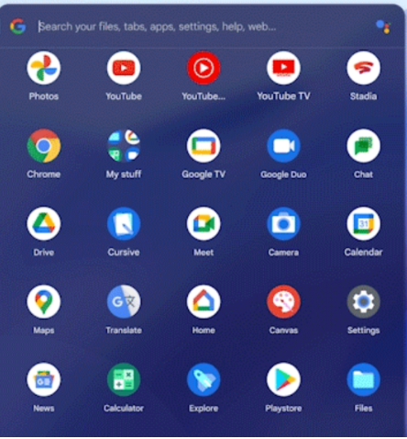
Chrome OS Version 100
New App launcher

Slide 20
Chrome OS version 100
Editing with Voice Dictation
After Dictation activation
Everything key + D
Create personal GIFs
Updated Android Container
Android Runtime for Chrome (ARC)
to
Android Runtime for Chrome VM

Slide 21
Chrome OS Creating Personal GIFs

Slide 22
Current Issues
DeadBolt ransomware
Seeks backup first

Slide 23
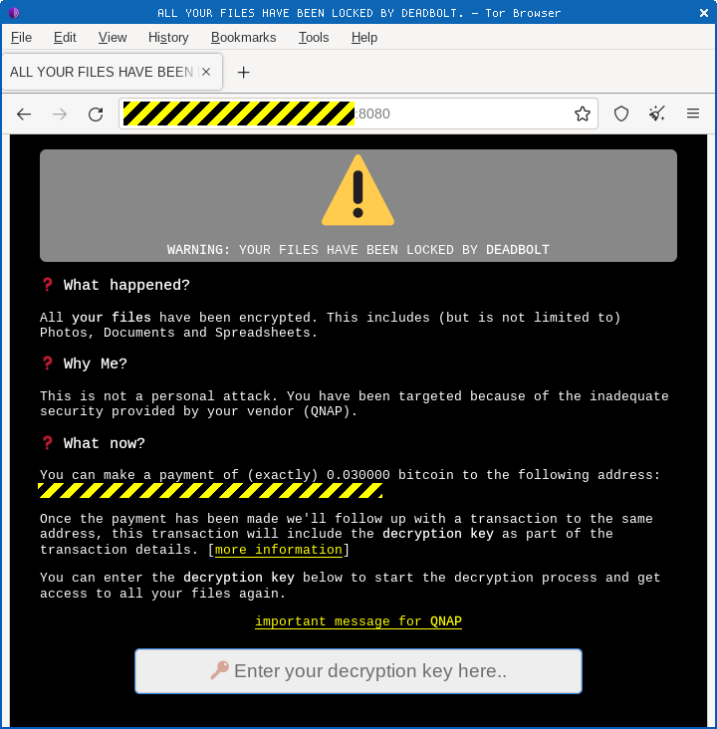

Slide 24
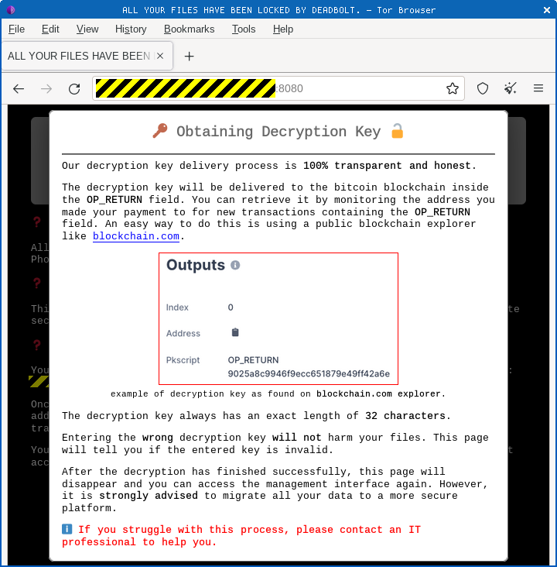

Slide 25
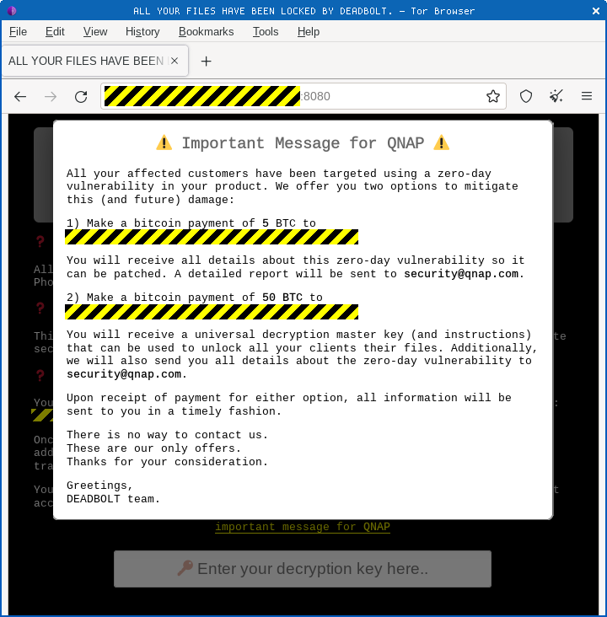

Slide 26
Alexa?
Delete everything …
Settings > Alexa Privacy > Manage Your Alexa Data
Enable deletion by voice
“Alexa, delete what I just said”
“Alexa, delete everything I said today”
Helpful <-> Harmful
Alexa, drop in
Device name - All devices
Confirmation tone
OTHER HOMES

Slide 27
Alexa Drop In setup
Alexa App
Devices > Echo & Alexa > Drop In
Enable
Allow Drop In
Alexa Calling & Messaging
BOTH parties must setup

Slide 28
Smart Speakers
Video Calling
Hands Free
“announce I am on my way home”
“Call for help” Emergency Contacts
Captioning
Whisper mode
Pair with Bluetooth
Beer Goggles
Skills

Slide 29
Borat RAT malware
Remote Access Trojan (RAT)
Spyware
Ransomware
Builder, feature modules, server certificate
DDoS
Record audio & video
Take control mouse and/or keyboard
Screen captures
Modify system settings
Stealing and/or deleting files Modification
Reverse proxy
Browser manipulations

Slide 31
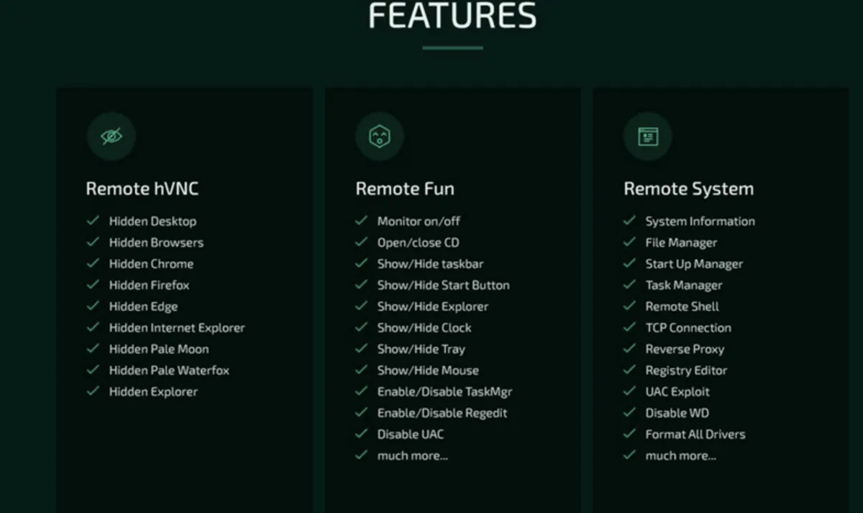

Slide 32
Car Key Fobs
RollJam attack
Yeahbut Honda still replay success
why ?
Little testing
even less accountability or regulation
And garage doors
shift registers

Slide 33
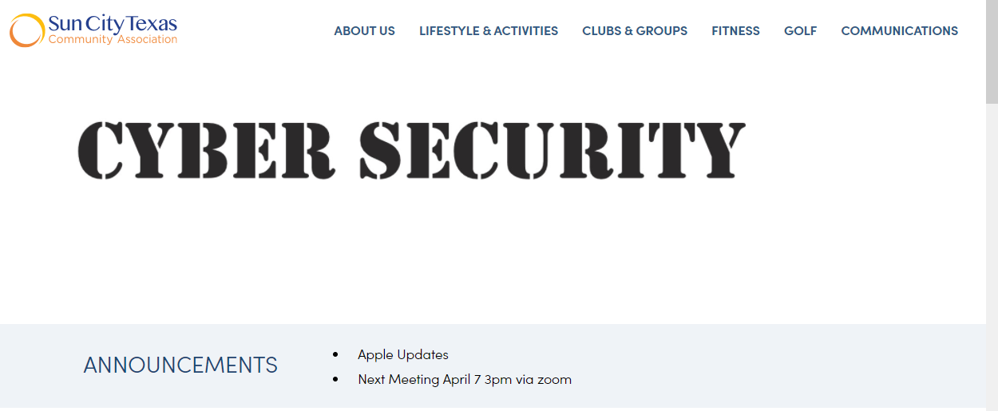
Cyber Security SIG updates
Cyber Security SIG web site to use ANNOUNCEMENTS

Slide 34
Cyber Security SIG updates
Announcements will usually be links
Click on link for more information
Example:

Slide 35
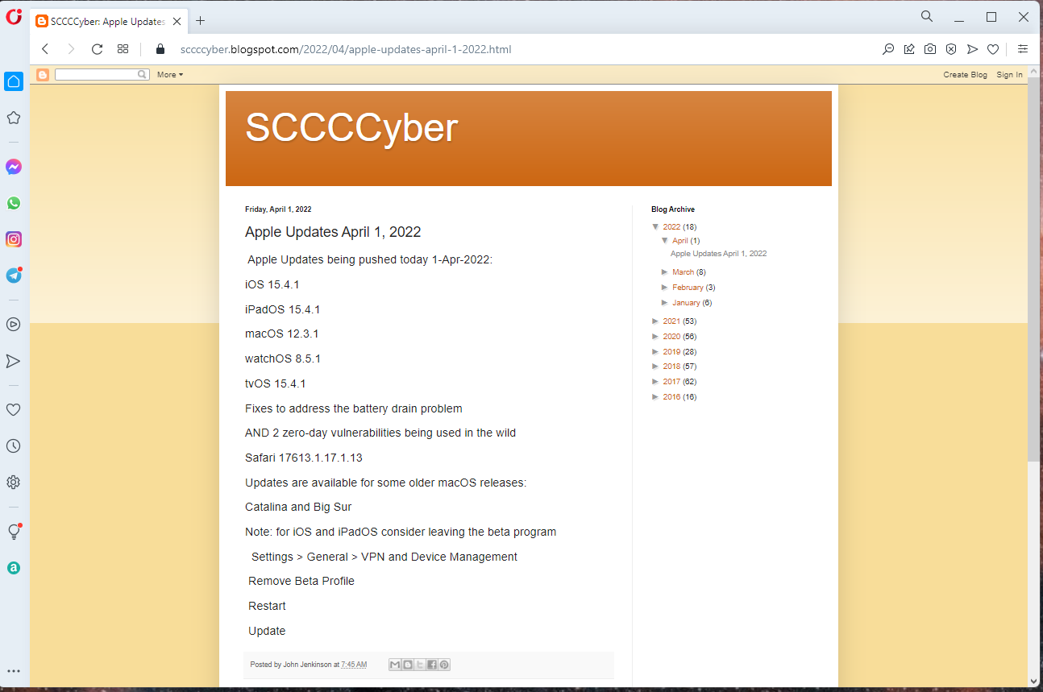

Slide 36
Mobile App Sun City CA
From Apple Store and/or Google Play Store
Search Sun City Community Association
Open Sun City Community Association App
Sign in with your Community Association credentials

Slide 37
Open Menu button

Slide 38
Select the CA site

Slide 40
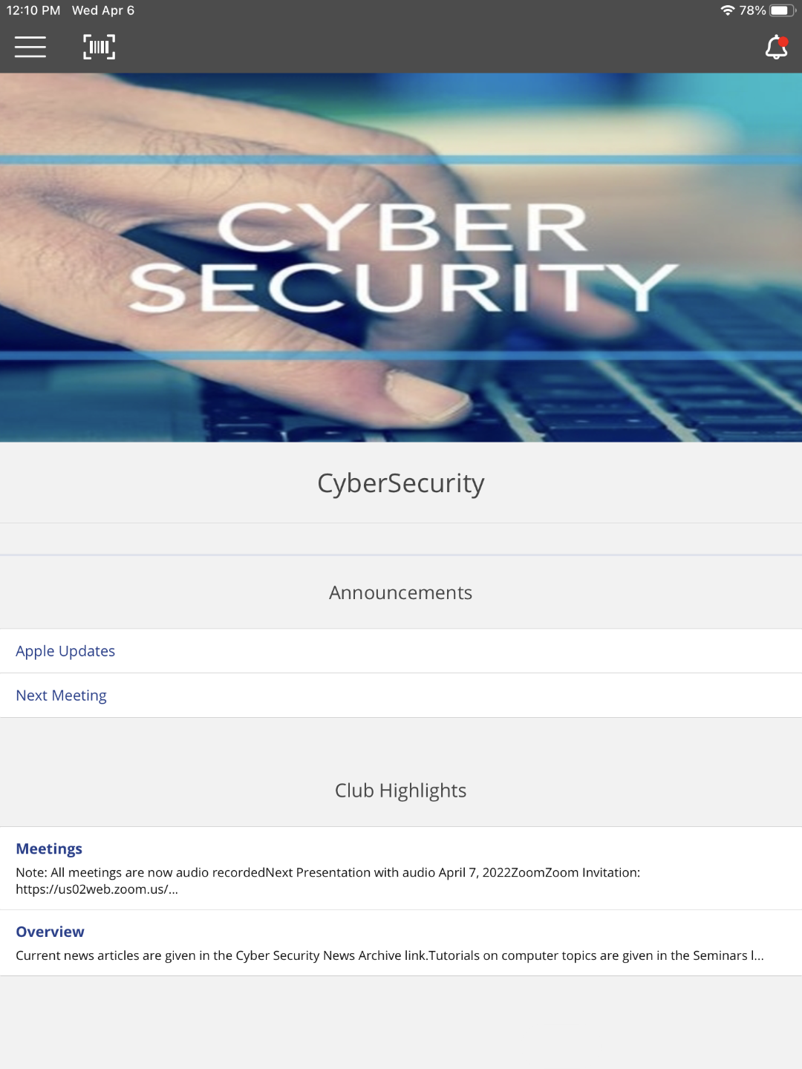

Slide 41
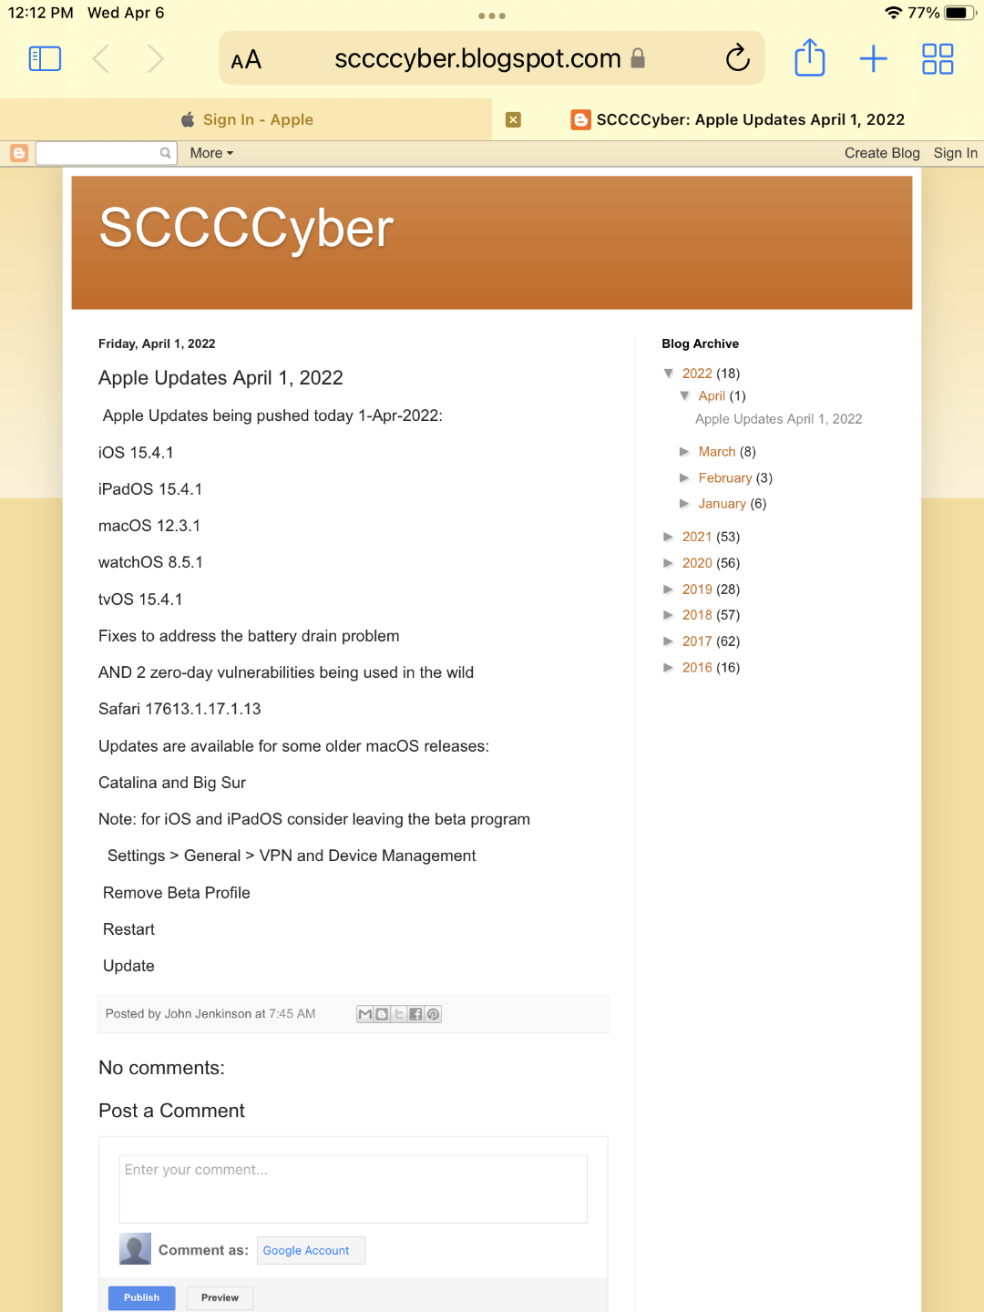

Slide 42
Current Issues
MLB to use Pitch Calling system

Slide 43
SCCCCyber@gmail.com
Helpful < - > Harmful
Awareness, Preparedness, Understanding
Computer Club, Help Center, SIGs, Presentations, FirstTime, classes
Cyber Security SIG meetings, NEWSBLOG
Internet
Questions, suggestions, comments?

